Slide 1

Micro Processors & Interfacing
16CS307
Mr. M Krishna Chennakesava Rao,
Asst. Professor, Dept. of ECE,
VFSTR University

Slide 2
Advantages due to Memory Segmentation
In 8086 microprocessor, memory is divided into 4 segments.
It allows the memory addressing capacity to be 1 Mbyte even though the address associated with individual instruction is only 16-bit.
It allows instruction code, data, stack and portion of program to be more than 64 KB long by using more than one code, data, stack segment, and extra segment.
It facilitates use of separate memory areas for program, data and stack.
It permits a program or its data to be put in different areas of memory, each time the program is executed i.e. program can be relocated which is very useful in multiprogramming.
Program can work on several data sets by reloading the DS register.

Slide 3
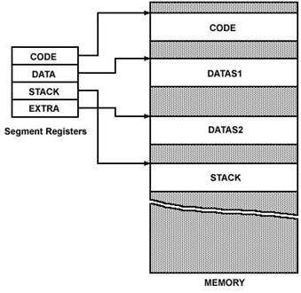
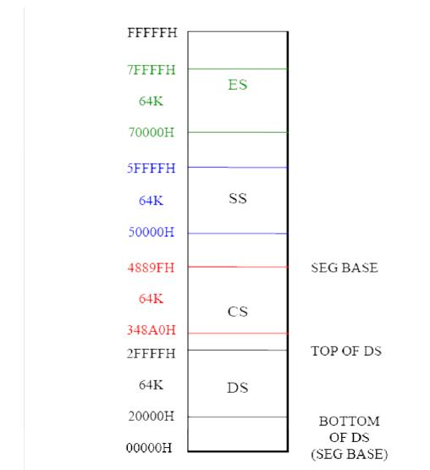
Architecture of 8086 Microprocessor
Memory Segments of 8086
Memory Segments of 8086
Segment Registers
Ref: Hall

Slide 4
Memory Segments of 8086 cont’d…
Segment Registers generate memory address when combined with other in the microprocessor.
In 8086 microprocessor, memory is divided into 4 segments as follow:
Code Segment (CS): The CS register is used for addressing a memory location in the
Code Segment of the memory, where the executable program is stored.
Data Segment (DS): The DS contains most data used by program. Data are accessed in the
Data Segment by an offset address or the content of other register that holds the offset
address.
Stack Segment (SS): SS defined the area of memory used for the stack.
Extra Segment (ES): ES is additional data segment that is used by some of the string to hold
the destination data.

Slide 5
Physical Address Generation
8086 processor addresses segmented version of memory ( 2²⁰ =1MB size).
Size of each segment is 64KB. (2²⁰ = 2⁴ 2¹⁶ = 2⁴. 64KB= Sixteen 64KB logical segments)
All 4 segment registers give the base addresses of selected segments.
Segments starting address are like→00000H, 10000H, 20000H, 30000H…. F0000H
Segments Ending address are like→0FFFFH, 1FFFFH, 2FFFFH, 3FFFFH…. FFFFFH
Offset address range in any segment is →from 0000H to FFFF
Address range of total 1MB is →from 00000H to FFFFFH
Physical address =[ Base address * 10 ] + OFFSET address
No. of locations are getting down from segment base to desired address in the segment is called Offset Address or Effective address.
Physical Address means actual location address in the memory system.
Note: Here base address will be shifted LEFT by 4-bit positions.

Slide 6
Physical Address Generation : Tutorials
a) If the code segment for an 8086 program starts at address 70400H. What number will be in the CS register? Assuming this same code segment base, what physical address will a code byte be fetched from, if the Instruction Pointer(IP) contains 539CH?
What physical address is represented by
a) 4370: 561EH b) 7A32 : 0028H
3. If the Stack segment register contains 3000H and the stack pointer register contains 8434H, What is the physical address of the top of the stack?
If the 8086 execution unit calculates an effective address of 14A3H and DS contains 7000H, What Physical Address will the BIU produce?
If SS:SP form as 5000: FFE0H. Find physical address.
If CS=348AH: IP=4214H. Then find the 20-bit physical address .
CS |  | 3 | 4 | 8 | A | 0
IP | + |  | 4 | 2 | 1 | 4
PA |  | 3 | 8 | A | B | 4

